Slide 1
Deadline-Aware Logistics
Scheduling & Delivery
Performance Evaluation
A data-driven C++ system for scheduling shipments, managing delays, and measuring delivery outcomes.
COURSE
PRESENTED BY
PROJECT GUIDE
DSA0710 Object Oriented Programming for C++
KAVIYA V (192421022)
M.NITHIYASHREE (192421101)
Lakshita S (192524108)
Nanditha (1965260011)
Mr. JEGADEESH K
Industrial Professional
Coimbatore

Slide 2
CAPSTONE PROJECT
Abstract
A unified workflow from shipment registration to measurable delivery performance.
PROJECT FOCUS
Deadline-aware scheduling
Dynamic delay management
Algorithm performance comparison
• Captures order details, deadlines, priority, vehicle capacity, distance, and driver availability.
• Builds delivery sequences using sorting, greedy rules, job sequencing, and priority queues.
• Replans pending shipments when delays or urgent orders change the schedule.
• Evaluates on-time delivery, lateness, total delivery time, and completed shipments.
• Exports results to CSV or stores shipment history in SQLite.
C++
STL
CSV
Expected contribution
More transparent and adaptable shipment planning.
DEADLINE-AWARE LOGISTICS SCHEDULING • C++ / STL / OOP
02 / 13

Slide 3
CAPSTONE PROJECT
Problem Statement
01 Fragmented constraints
02 Changing conditions
03 Limited visibility
Orders differ in deadlines, priority, package weight, route distance, and estimated travel time.
Traffic delays, driver unavailability, and urgent orders can make a fixed schedule ineffective.
Without common metrics, it is difficult to identify late shipments or compare scheduling strategies.
CORE QUESTION
How can shipments be scheduled and rescheduled to improve deadline adherence while respecting capacity and driver constraints?
Deadlines
Vehicle capacity
Delay events
Driver availability
DEADLINE-AWARE LOGISTICS SCHEDULING • C++ / STL / OOP
03 / 13

Slide 4
CAPSTONE PROJECT
Project Objectives
01
Manage shipment orders
Register, validate, update, and store shipment information.
02
Optimize the sequence
Apply deadline/priority sorting and greedy selection.
03
Adapt to disruptions
Recalculate pending schedules when delays or urgent orders occur.
04
Measure delivery outcomes
Compute on-time rate, late count, lateness, and total delivery time.
05
Compare algorithms
Run strategies on the same test orders and export performance reports.
DEADLINE-AWARE LOGISTICS SCHEDULING • C++ / STL / OOP
04 / 13

Slide 5
CAPSTONE PROJECT
Proposed System Workflow
01
02
03
04
05
Register
Prioritize
Schedule
Monitor
Evaluate
Order details & constraints
Deadline, priority, urgency
Sequence feasible jobs
Delay & status updates
KPIs & reports
Scheduling rules
Rescheduling rules
Respect vehicle capacity and driver availability; prioritize urgent and near-deadline orders when feasible.
Keep completed deliveries fixed, update estimated arrival times, and rebuild the pending schedule after disruptions.
DEADLINE-AWARE LOGISTICS SCHEDULING • C++ / STL / OOP
05 / 13

Slide 6
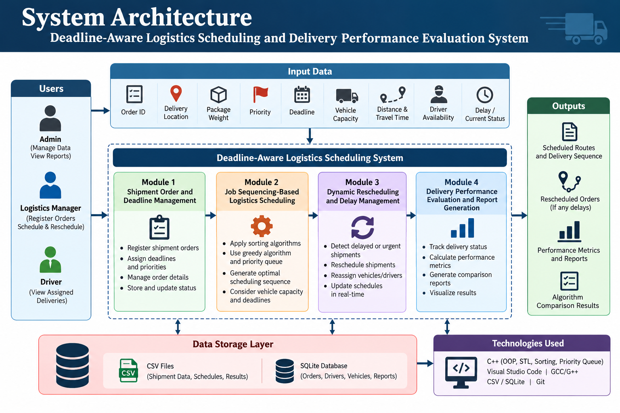
System Architecture Diagram
DEADLINE-AWARE LOGISTICS SCHEDULING • C++ / STL / OOP
06 / 13

Slide 7
CAPSTONE PROJECT
Module 1 — Shipment Order & Deadline Management
Purpose: maintain clean shipment records and validate every order before scheduling.
Captured parameters
Object-oriented model
Order operations
Order ID • delivery location
Package weight • priority
Deadline • distance • travel time
Delivery status • delay
Shipment class stores order data.
Methods: validate(), updateStatus(),
estimateArrival().
vector<Shipment> stores orders.
Create and edit orders
Check unique IDs and valid values
Assign deadlines and priority
Save/load through CSV or SQLite
SAMPLE ORDER
ORD-104 | Chennai | 8 kg | High | 17:00 deadline | 24 km | Pending
Create / Update
Validate
Persist data
DEADLINE-AWARE LOGISTICS SCHEDULING • C++ / STL / OOP
07 / 13

Slide 8
CAPSTONE PROJECT
Module 2 — Job Sequencing-Based Scheduling
Purpose: produce a feasible sequence that balances deadlines, urgency, and resource constraints.
Scheduling strategies
C++ implementation
Feasibility checks
• First-Come, First-Served (FCFS)
• Earliest Deadline First (EDF)
• Priority-based sorting
• Greedy feasible selection
• std::vector for shipment lists
• std::sort with custom comparator
• std::priority_queue for urgent jobs
• Classes for Vehicle and Driver
• Weight must fit vehicle capacity
• Driver must be available
• Travel time must fit schedule
• Deadline feasibility is evaluated
Illustrative sequence
Pending orders
Rank candidates
Check resources
Schedule
A • B • C • D
Deadline + priority
Capacity + driver
B → A → D → C
DEADLINE-AWARE LOGISTICS SCHEDULING • C++ / STL / OOP
08 / 13

Slide 9
CAPSTONE PROJECT
Module 3 — Dynamic Rescheduling & Delay Management
Purpose: adapt the pending schedule when real-world conditions change.
Rescheduling triggers
Rescheduling process
Operational safeguards
Traffic-related delay
Vehicle issue or capacity change
Driver becomes unavailable
New urgent shipment arrives
Update travel/arrival estimates
Identify orders at risk
Re-rank pending shipments
Assign available resources again
Do not alter completed deliveries
Preserve shipment history
Record delay reason and duration
Recompute affected KPIs
EXAMPLE
If Order B is delayed by 30 minutes, recalculate its ETA, flag deadlines at risk, and rebuild the pending sequence.
Detect
Recalculate
Reassign
Log outcome
DEADLINE-AWARE LOGISTICS SCHEDULING • C++ / STL / OOP
09 / 13

Slide 10
CAPSTONE PROJECT
Module 4 — Performance Evaluation & Reports
Purpose: turn delivery outcomes into comparable performance measures.
On-time delivery rate
Late shipment count
On-time completed orders ÷ completed orders × 100
Number of orders delivered after their deadlines
Average delivery lateness
Total delivery time
Total late minutes ÷ number of late orders
Sum of delivery durations for completed shipments
Completed shipments
Scheduling efficiency
Count of orders with Delivered status
Feasible completed jobs ÷ eligible jobs × 100
Report fields: algorithm • on-time rate • late orders • average lateness • total time • runtime
DEADLINE-AWARE LOGISTICS SCHEDULING • C++ / STL / OOP
10 / 13

Slide 11
CAPSTONE PROJECT
Advantages & Expected Outcomes
Deadline-aware
Adaptive
Makes delivery deadlines a first-class scheduling constraint.
Replans pending shipments after delays or urgent orders.
Resource-conscious
Measurable
Checks vehicle capacity, distance, travel time, and driver availability.
Tracks delivery performance through defined KPIs.
Modular C++ design
Comparable algorithms
Separates shipment data, scheduling logic, persistence, and reporting.
Supports evidence-based comparison of FCFS, EDF, and greedy strategies.
Target outcome: more reliable scheduling decisions and clear, reproducible delivery-performance reports.
DEADLINE-AWARE LOGISTICS SCHEDULING • C++ / STL / OOP
12 / 13

Slide 12
THANK YOU!

